Slide 1
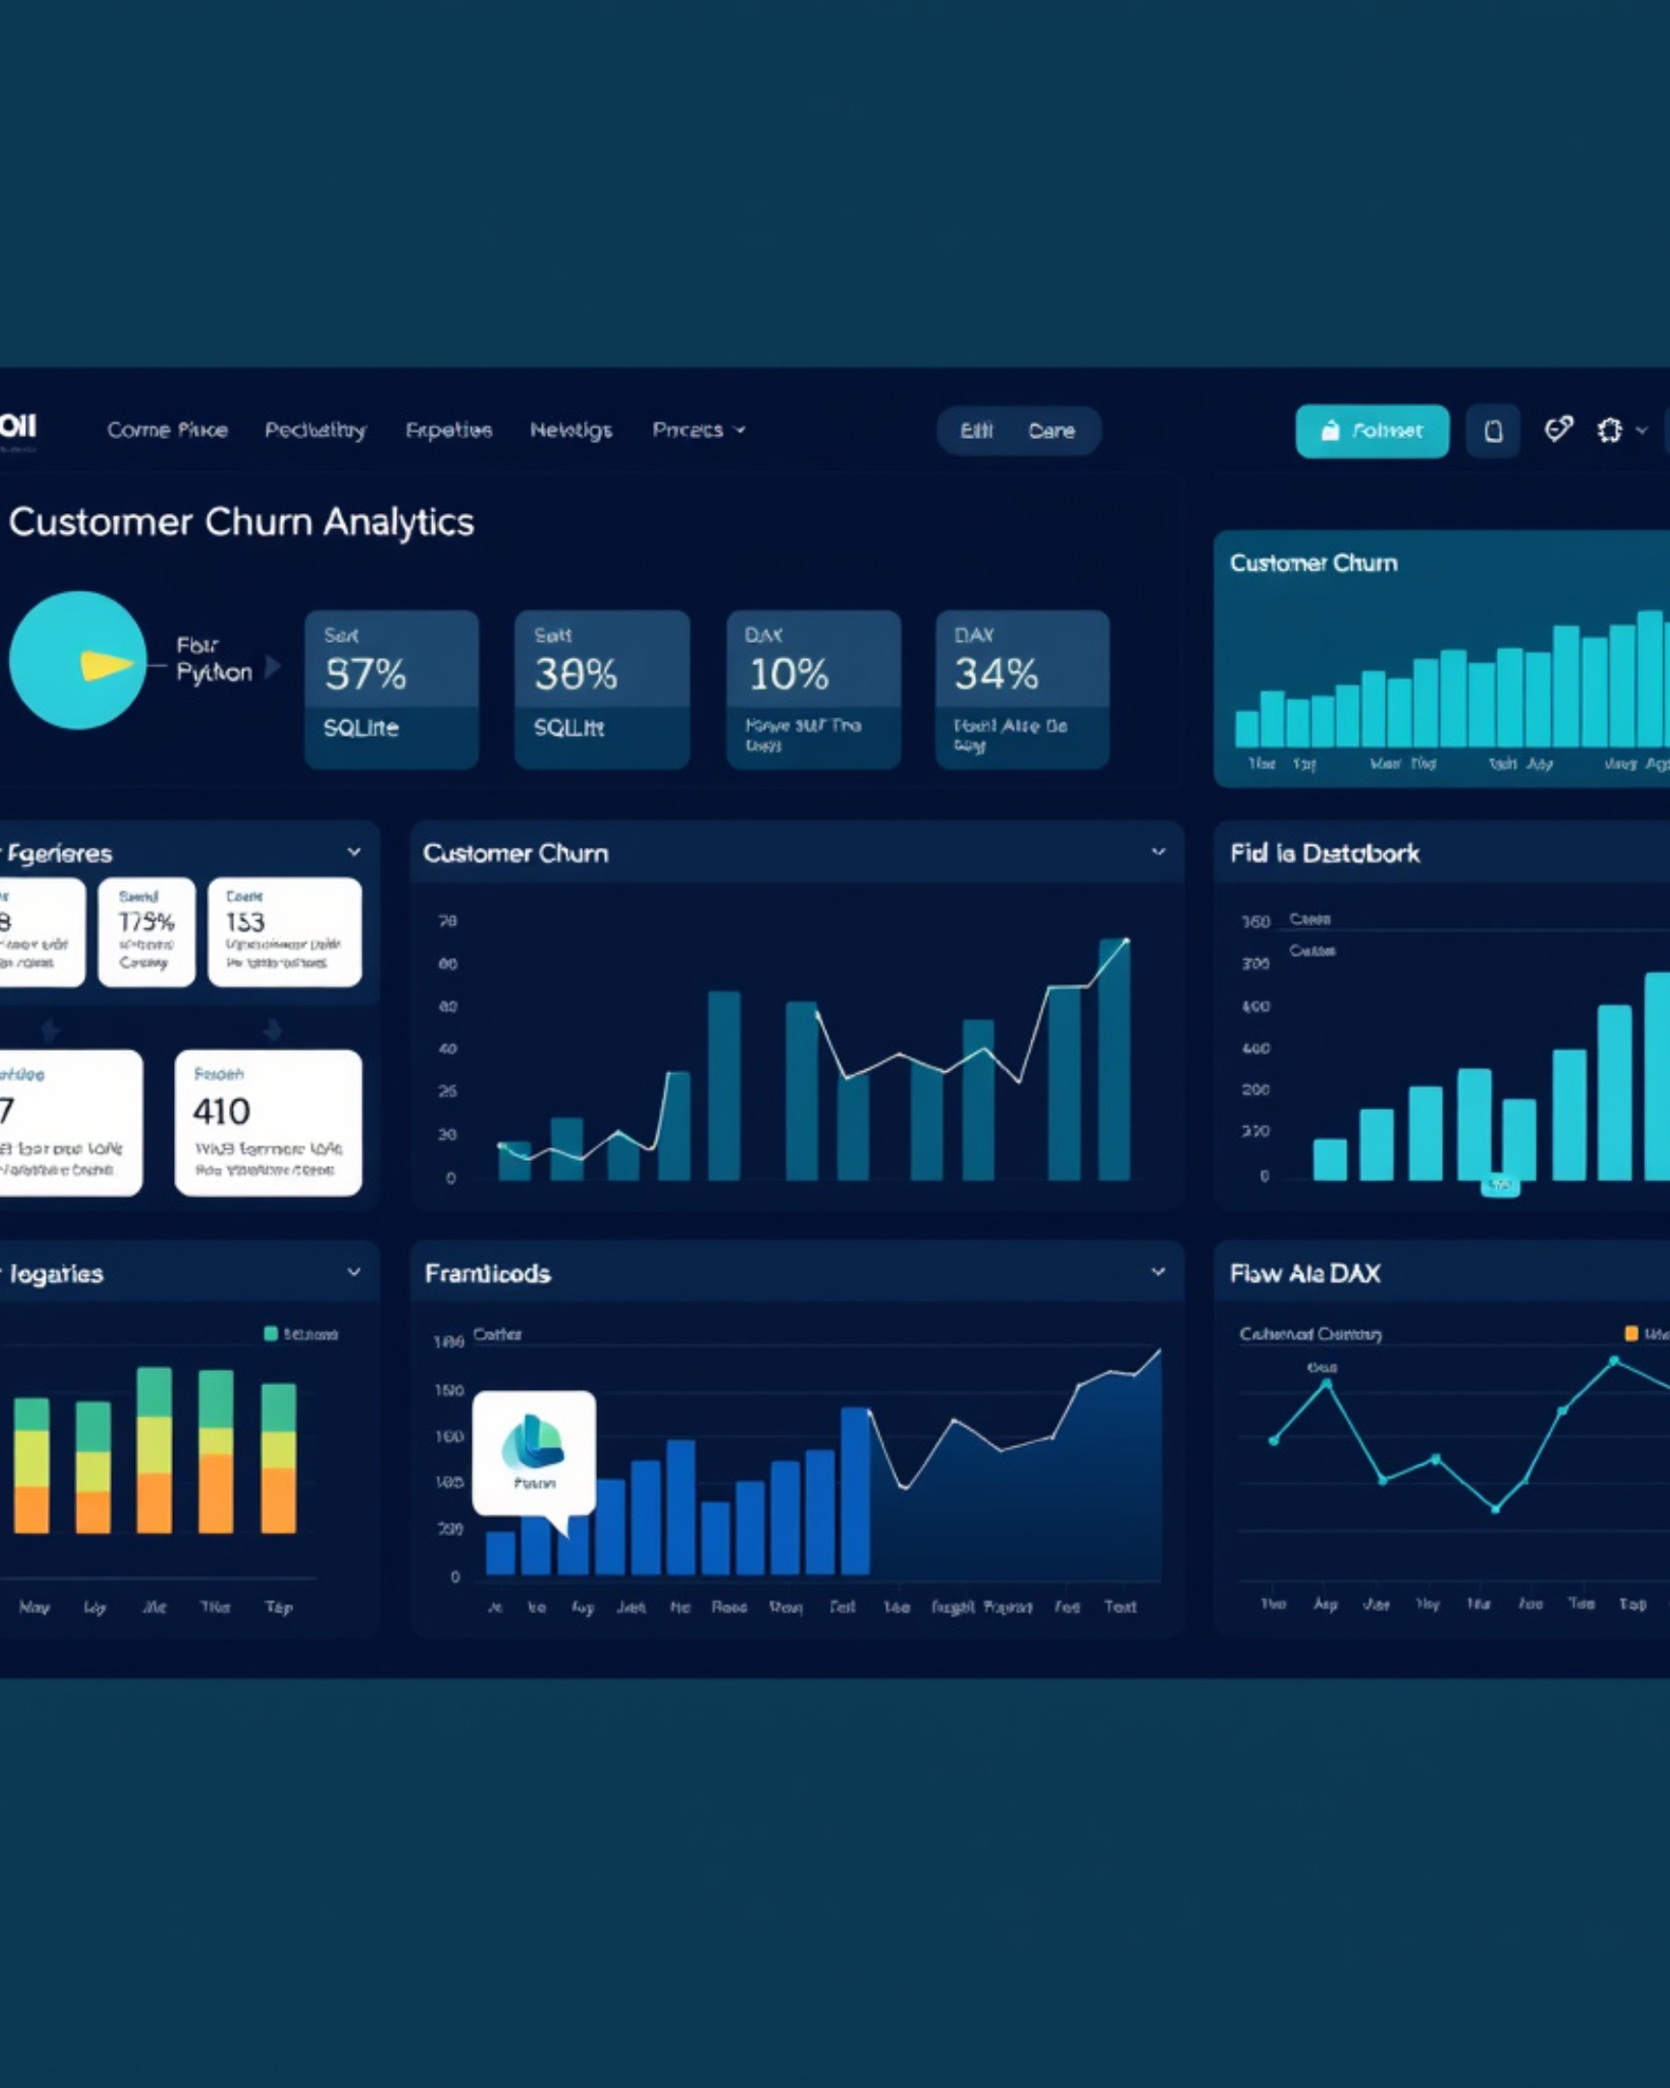




CUSTOMER RETENTION ANALYTICS
Customer Churn & Retention Analytics
A dashboard-driven study of churn signals, retention levers, and business decisions.
Project Identity
STUDENT NAME
ROLL NUMBER
Your Name Here
Your Roll No.
DEPARTMENT
INSTITUTION
Information Technology
College Name / Guide Name / Academic Year
SQLite
Python
Power BI
DAX
SQLite
Python
Power BI
Raw customer records and service history
Cleaning, modeling, and churn feature prep
Executive dashboard and retention insights

Slide 2











CUSTOMER RETENTION LENS
Why Customer Churn Matters
When customers leave, recurring revenue, retention, and forecasting all become harder to trust.
Customer-to-retention flow
What the team needs to know
A simple path from active users to churn, then back to retention action.
Retention focus
Use analysis to turn churn into clear next steps.
Who leaves?
Active customers
Spot the customer segments with the highest risk.
Subscription or service is in use
Why do they leave?
Churn event
Find the patterns behind cancellations and inactivity.
Customer discontinues the relationship
Retention action
How much revenue is lost?
Identify risks, intervene, and recover value
Quantify recurring revenue at risk before it compounds.
Solution path
Churn is not just a customer loss event — it is a revenue signal.
Power BI + Python analysis
Python Analysis + Power BI Dashboard

Slide 3




PROJECT FRAMING
Problem Statement & Objectives
A clear viva-friendly split: what makes churn hard to see, and what this analysis will deliver.
Challenge
Objectives
The hard part is finding which customer groups are most likely to leave — and how much that churn costs.
Build a churn view that links metrics, drivers, and recommendations in one Power BI story.
High-churn segments are difficult to identify early.
Calculate churn and retention metrics.
Churn impact is hard to quantify without segment-level analysis.
Analyze churn by plan, contract, and geography.
Deliver interactive Power BI insights with recommendations.
Without visibility, retention action stays reactive instead of targeted.
Verdict
This project turns churn from a hidden business risk into a measurable, segment-level dashboard for action.
Problem → Metrics → Insights

Slide 4





DATASET & STRUCTURE
Three sources, one churn dataset
SQLite tables feed a merged analytics layer built for churn analysis and model-ready fields.
Customers
Subscriptions
Support
Core customer profile table in customer_churn.db, anchoring identity and account-level attributes.
The central transaction layer, carrying plan and contract details that explain retention risk.
Service interaction signals that help explain escalation patterns, dissatisfaction, and churn outcomes.
Customer identifiers and profile fields
Support history and issue context
One side of the merge key structure
plan_type and contract_type
Enriches churn_score interpretation
Main bridge into churn modeling
Merged analytic view
KEY FIELDS
The three tables are joined into a single final dataset with 5,021 records and 21 columns, centered on plan_type, contract_type, monthly_charges, cancellation_date, and churn_score.
FINAL DATASET
plan_type · contract_type · monthly_charges
5,021 × 21
cancellation_date · churn_score

Slide 5







ANALYTICS WORKFLOW
Technology Stack & Project Workflow
A clean pipeline from SQLite3 data to Python analysis, then into Power BI dashboards and DAX measures.
End-to-end workflow
Data moves left to right — preparation, analysis, visualization.
SQLite3
Python loading
Analysis layer
Power BI + DAX
Source tables and raw records
Ingest, clean, and structure the dataset
Pandas, NumPy, Matplotlib, Seaborn
Dashboard delivery and KPI calculation
Data preparation
Visualization
BI delivery
Pandas and NumPy shape the data for analysis.
Matplotlib and Seaborn support exploratory insights.
Power BI presents the dashboard; DAX calculates KPI measures.

Slide 6







DATA PREPROCESSING & FEATURE ENGINEERING
Raw SQLite tables became churn-ready features
A compact pipeline: clean the fields, standardize the data, and derive the churn signals used downstream.
Process steps
BEFORE → PROCESS → AFTER
Turn messy records into model-ready signals
Load the source data
SQLite extracted in Python with SQLite3 and Pandas.
The preprocessing layer makes the churn story consistent, measurable, and ready for analysis.
Clean and standardize
Renamed columns, filtered rows, standardized gender, converted dates.
Before
Raw SQLite tables
Create churn features
Built churn_flag from cancellation date and churn_risk bands: Low, Medium, High.
Process
Rename, filter, standardize, convert
After
Churn flag + risk tiers

Slide 7


EXPLORATORY DATA ANALYSIS
Churn is concentrated in the Basic plan
Python exploration surfaced churn, segment, and correlation patterns; plan-level churn shows where retention pressure is strongest.
Plan-wise churn comparison
Python EDA
OVERALL CHURN RATE
Basic plan churn sits above the overall average.
30.67%
Baseline for the customer base
HIGHEST PLAN CHURN
31.81%
Basic plan leads the churn risk
Insight
Focus retention analysis on Basic customers first; it is the clearest churn hotspot in the EDA.

Slide 8



CHURN & RETENTION OVERVIEW
Retention stays strong, but churn still removes nearly one in three customers.
Total customers: 5,021
Churn rate: 30.67%
Retention rate: 69.33%
Total Customers
Churned Customers
Active Customers
5,021
1,540
3,481
Base population measured across the full customer set.
Customers lost from the active base during the period.
Customers retained and still contributing to the base.

Slide 9



REVENUE AT RISK
Churn is putting ₹77,089 of monthly revenue at risk
That translates to an estimated ₹9.25 lakh per year if the current churn pattern persists.
Monthly revenue at risk
Churn-linked
Annualized impact
Revenue exposed each month when customers with churn_flag = 1 are counted.
₹9.25 lakh
₹77,089
Approximate yearly impact from the current monthly risk.
Where to focus
Identify premium accounts showing churn signals early, then prioritize retention before revenue leaks compound.
Protect the premium base first
Premium customers contribute the largest revenue affected by churn.
Premium accounts
Early churn signals

Slide 10
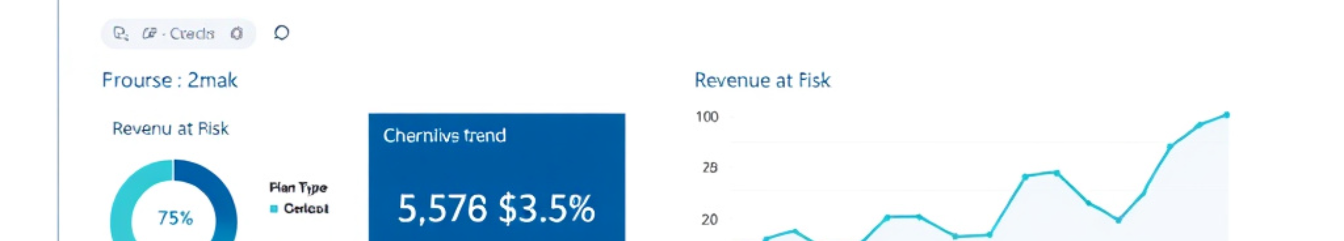
INTERACTIVE POWER BI DASHBOARD
Churn, retention, and revenue risk in one executive view
Prominently place the dashboard screenshot, then use short callouts to explain filters, KPI cards, and the main churn views.
What the dashboard answers
Filters stay executive-friendly
It connects customer health to business risk: who is leaving, where churn concentrates, and which segments deserve immediate action.
Plan Type, Gender, Contract Type, and State keep the view interactive without crowding the page.
Use the screenshot as the primary visual, then speak to the two most important actions.

Slide 11

POWER BI DAX MEASURES
Build churn, retention, and risk from a few reusable measures
Keep the logic readable: count customers, isolate churned rows, protect ratios with DIVIDE, then surface revenue at risk with one filter.
Measure pattern
How to read it
Short formulas that stay easy to audit and reuse
DAX
Count the base population first.
Total Customers
COUNTROWS(Sheet1)
Use CALCULATE to filter churned rows.
Use DIVIDE for ratios with safety.
Churned Customers
CALCULATE(COUNTROWS(Sheet1), Sheet1[churn_flag] = 1)
Churn Rate / Retention Rate
DIVIDE(churned customers, total customers)
Safe division keeps blanks and zero totals from breaking the report.
PRESENTER TAKEAWAY
Reusable measures make churn analysis fast, explainable, and dashboard-friendly.
Revenue at Risk
SUMX(churned rows, monthly_charges)
Shows the financial impact of churn, not just the customer count.

Slide 12

CHURN COMPARISON
Where Is Churn Highest?
Basic leads the plan mix, while monthly contracts remain the clearer churn risk.
Plan-wise churn
HIGHEST PLAN
Contract-wise churn
Small spread, but Basic is highest.
31.81%
Monthly contracts churn more than annual contracts.
Basic
Monthly contracts
HIGHER CHURN
31.81%
Highest churn in the plan set
More customer movement, less retention stability.
Standard
30.48%
Slightly below Basic
Annual contracts
Premium
29.77%
More stable tenure, lower churn pressure.
Lowest among the three
Verdict
Churn concentrates at the lower end of the plan stack and is stronger on monthly contracts than annual ones.
Retention focus: Monthly + Basic

Slide 13







KEY INSIGHTS
Key Insights from the Analysis
A quick viva-ready summary of churn, retention, and the revenue exposure hidden inside the basic plan.
Churn pressure
Retention strength
Revenue at risk
30.67%
69.33%
₹77,089
retained
Overall churn is material, so retention work should start with the largest exit drivers.
The business still retains a strong majority, giving a solid base to protect and expand.
Monthly revenue exposure is large enough to justify focused retention actions.
Basic plan shows the highest churn rate.
Retention remains stronger than churn.
Every churn reduction directly protects cash flow.
Plan-level churn is where intervention matters most.
This is a repair-and-grow story, not a rescue.
Basic-plan customers are the key risk pool.
Five viva points are compressed into three blocks for fast recall.
Retain the base, fix the basic plan, protect ₹77,089 monthly.

Slide 14




BUSINESS RECOMMENDATIONS
Focus retention where churn risk is highest
Priority lens
Retention first
Prioritize Basic-plan and monthly-contract customers.
Target the highest-risk customer segments, reduce avoidable cancellations, and act earlier on service issues.
Finding: Basic-plan and monthly-contract customers are the highest-priority segment.
RECOMMENDED SEQUENCE
Find the churn trigger, intervene early, then track the savings.
Action: Build a targeted save list for these accounts and route them into a focused retention workflow.
Expected benefit: Earlier intervention on the customers most likely to leave.
Finding: Price-related cancellations need a direct response.
Segment the right customers
Action: Investigate the price-triggered churn path and test targeted retention offers before cancellation completes.
Basic-plan and monthly-contract accounts.
Expected benefit: Better save rates without broad discounting.
Intervene on price risk
Use targeted retention offers before cancellation.
Finding: Revenue at risk varies by market and support experience.
Strengthen service quality
Action: Monitor revenue at risk by geography and improve support quality to reduce escalations.
Reduce escalations and revenue at risk.
Expected benefit: Clearer regional action plans and fewer service-driven cancellations.

Slide 15



CONCLUSION & FUTURE SCOPE
From analysis to action
Built Python analysis, KPI calculations, Power BI dashboard, and DAX measures to turn churn into a clear business story.
Result
Result
Impact
30.67%
69.33%
₹77,089
Churn rate
Retention rate
Monthly revenue affected
Future scope
Next steps
Extend this foundation into predictive, real-time customer retention operations.
Machine learning prediction
Real-time dashboard
Alerts and CLV
CRM integration
Thank you
Questions & discussion

